Slide 1


APEX WEBINAR
Interim Career Framework
25 & 26 May 2026

Slide 2

Pay equity translations
Interim Career Framework (ICF)
‘Final’ Career Framework
‘Rough’ translations following pay equity settlement in Nov 2023
Reflected in current Designated placements
Purpose: To address any anomalies that arose from rough pay equity translations
Meant to have landed in 2024 – now expected June 2026
New interim frameworks have been developed by Health NZ for Degreed and Non-Degreed scales
Very limited union involvement
ALL staff in Designated roles will be translated to new scales; not all will have ‘upward’ movement
Any increases backdated to 1 July 2024
Job titles will not change as a result
Appeals process for challenging placement on the new scales
Purpose: To develop a systematic, reliable, evidence-based approach to sizing Designated roles across AST, Midwifery, and Nursing
Methodology and process developed in conjunction with unions
ALL AST, Nursing, and Midwifery Designated roles will be sized and placed on the new Career Framework – national consistency
Job titles may change as a result of this process
There will be an appeals process
Have questions? Get in touch: careerframework@apex.org.nz

Slide 3
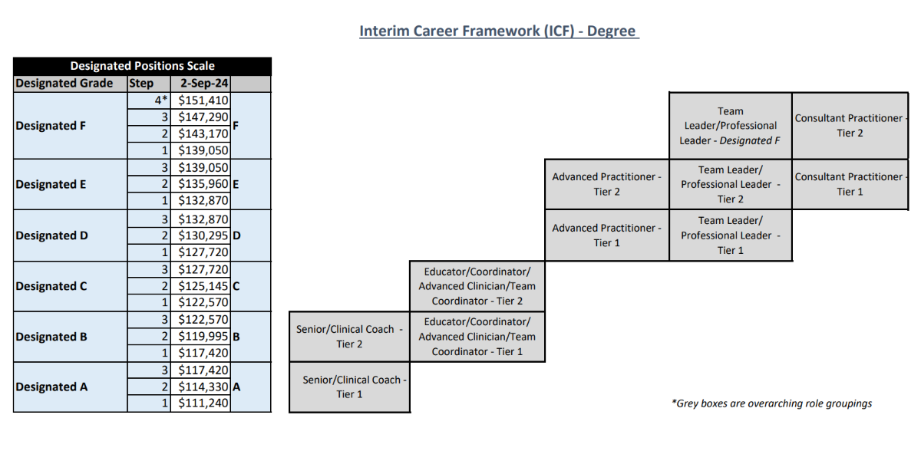
Have questions? Get in touch: careerframework@apex.org.nz

Slide 4
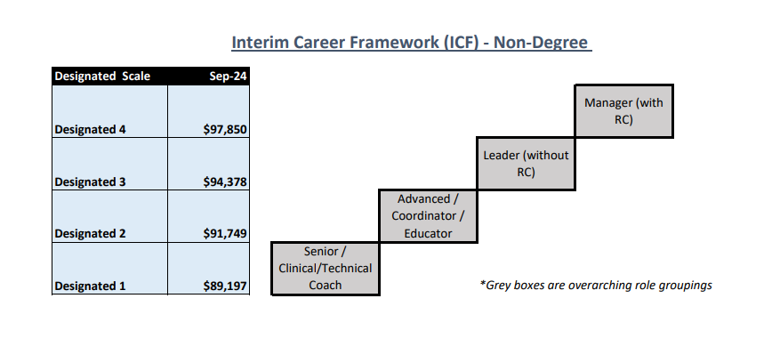
Have questions? Get in touch: careerframework@apex.org.nz

Slide 5
FAQs TO DATE
Job descriptions not up to date
Recent resignation
Disagree with placements on ICF (when notified)
Process for those not in ‘Designated’ roles
Have questions? Get in touch: careerframework@apex.org.nz

