Slide 1
AHST Interim Career Framework
June 2026

Slide 2
Overview
The ICF has been introduced to achieve greater consistency in the placement of roles on the new designated salary scales​
It is focussed on existing designated roles, it's not about creating new designated roles. ​
The ICF is an interim measure designed to promote greater consistency in role placement on salary scales. The Job Evaluation Tool (JET) project will provide a more comprehensive evidence base to determine the relative positioning of roles across our clinical workforces.

Slide 3
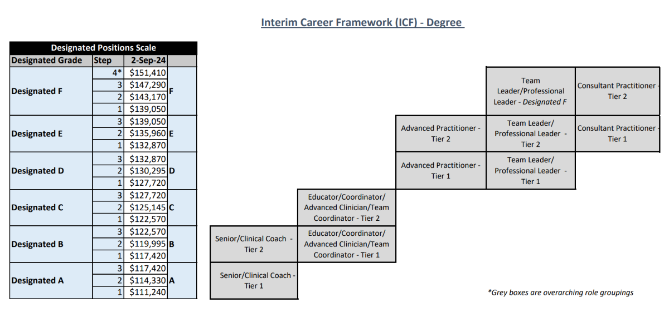
Roles may transition between steps within a band (e.g., A1 to A3) but cannot move across bands/tiers (e.g., from band A to band B or tier 1 to tier 2)

Slide 4
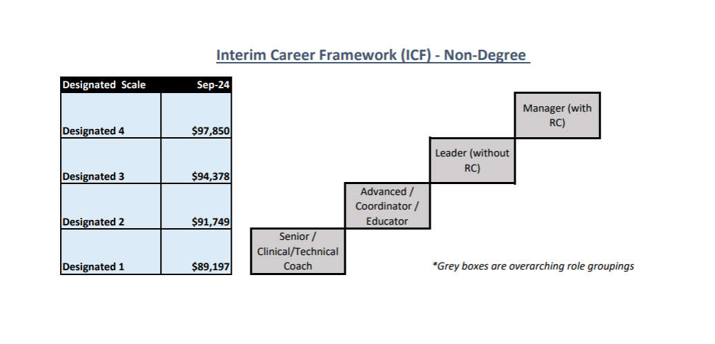
Non-degree scale

Slide 5
Designated degree roles to map to the ICF (~3380)
Region | District | Estimated total to map | Regional total
Northern | Northland | 109 | 1559
 | Waitematā | 342
 | Auckland | 671
 | Counties Manukau | 437
Te Manawa Taki | Waikato | 157 | 473
 | Lakes | 40
 | Bay of Plenty | 157
 | Taranaki | 82
 | Tairāwhiti | 37
Central | Whanganui | 32 | 684
 | Hawkes Bay | 218
 | MidCentral | 72
 | Wairarapa | 11
 | Cap, Coast & Hutt Valley | 351
Te Waipounamu | Nelson Marlborough | 74 | 664
 | Canterbury West Coast | 450
 | South Canterbury | 20
 | Southern | 120

Slide 6
Payment dates
As at 11 June 2026 (subjective to change) | Allied Health Interim Career Framework Salary Increase (1/7/2024) | Allied Health Interim Career Framework Back Pay (1/7/2024)
Auckland | 9/07/2026 | 9/07/2026
Bay of Plenty | 15/07/2026 | 30/08/2026
Canterbury | 24/6/2026 1/7/2026 | 8/7/2026 15/7/2026
Capital Coast | 24/06/2026 | 24/06/2026
Counties Manukau | 9/07/2026 | 9/07/2026
Hawkes Bay | 31/07/2026 | 31/07/2026
Hutt Valley | 24/06/2026 | 24/07/2026
Lakes | by 15/07/2026 | by 30/08/2026
MidCentral | 1/7/2026 8/7/2026 | by 29/7/2026 5/8/2026
Nelson Marlborough | 8/07/2026 | 8/07/2026
Northland | 10/06/2026 | 10/06/2026
South Canterbury | 12/06/2026 | 12/06/2026
Southern | 8/7/2026 15/7/2026 | 8/7/2026 15/7/2026
Tairawhiti | 1/07/2026 | 1/07/2026
Taranaki | 1/07/2026 | 29/07/2026
Waikato | 25/6/206 2/7/2026 | 25/6/206 2/7/2026
Wairarapa | 19/07/2026 | 17/07/2026
Waitemata | 9/07/2026 | 9/07/2026
West Coast | 10/6/2026 17/6/2026 | 24/6/2026 1/7/2026
Whanganui | 17/6/2026 24/6/2026 | by 15/7/2026 22/7/2026
National Office | 9/07/2026 | 9/07/2026
TAS | 9/07/2026 | 9/07/2026

Slide 7
ICF Mapping
Intent: To help address anomalies that arose from pay equity translations for designated roles
  Its about existing designated roles, it's not about creating new designated roles.
  Focus is on the role, not the person
  Change of language from “small and large” to “tier 1 and tier 2”.
Professions not included in PE/ICF implementation:
  Sonographers, Psychologists, Medical Physicists, MRI and Nuclear Medicine, Perfusionists.
Minimum steps in collective agreements will continue to apply.

Slide 8
ICF Mapping cont.
The mapping was based on the role requirements, not the person in the role. There may be people that are working over and above the requirements of the role, but this cannot be recognised through where the role sits in the ICF.
Movement within a grade is by automatic progression. Movement to another grade is by appointment to a role.
The tier one and two mapping recognises that there may be roles that have the same title, but are a different size due to the requirements of the role (environment, complexity etc). Moving from a tier one role to a tier two role would be by appointment, because they are different sized roles.

Slide 9
ICF Mapping cont.
As part of the 2023 pay equity settlement, Health NZ and the unions agreed to discontinue merit and CASP pay progression. This reflected feedback that performance-based progression could be perceived as subjective and may not align with the principles of an equitable pay system.
The intention was to separate remuneration from performance assessment, while continuing to use performance and development reviews to support professional growth, career development, and ongoing learning

Slide 10
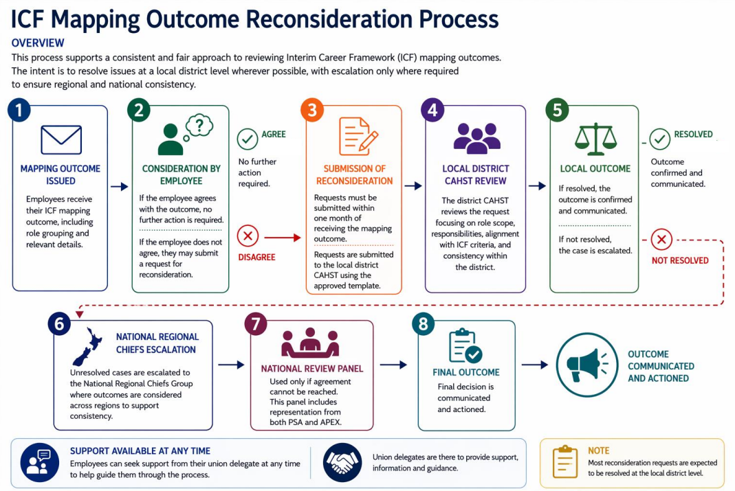

Slide 11
What’s next?
Job Evaluation Project (JET)
Final Career Framework

Slide 12
Questions?

